Slide 1
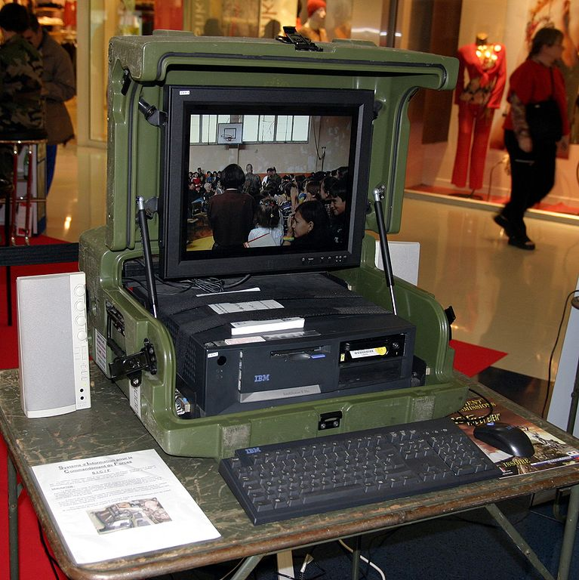
Mobile and Desktop Applications with C♯
Rasmus Lystrøm
Associate Professor
ITU
This Photo by Unknown Author is licensed under CC BY-SA

Slide 2


Guest Lecture
Ali Reza Farahnak
Global Senior Customer Engineer
Mobile Application Development with C♯
This Photo by Unknown Author is licensed under CC BY

Slide 3

Agenda
Mobile and Desktop Applications (by Ali)
MVVM Architectural Pattern
Xamarin.Forms
.NET Multi-platform App UI (MAUI)
Upgrading .NET applications
C♯ 10
Catch up on other C♯ patterns
Blazor follow-up
Windows Applications
Windows Forms (WinForms)
Windows Presentation Foundation (WPF)
This Photo by Unknown Author is licensed under CC BY-NC-ND

Slide 4
Upgrading .NET Applications

Slide 5
The Tools
dotnet tool install --global upgrade-assistant
dotnet tool install --global try-convert
upgrade-assistant analyze <csproj/sln>
upgrade-assistant upgrade <csproj/sln> --skip-backup

Slide 6
Update your stack
Get the latest .NET SDK: https://dot.net/
dotnet tool list --global
dotnet tool update --global dotnet-ef
dotnet list package --outdated

Slide 7
Update your .csproj files
<Project Sdk="Microsoft.NET.Sdk">
<PropertyGroup>
<TargetFramework>net6.0</TargetFramework>
<Nullable>enable</Nullable>
<ImplicitUsings>enable</ImplicitUsings>
</PropertyGroup>
</Project>

Slide 8
Upgrading .NET Applications
Demo

Slide 9
C♯ 10 / .NET 6.0

Slide 10
Important new features
Global using directives
Implicit using directives
Implicit Program.Main from C♯ 9 is now default
File-scoped namespace declaration
Nullable reference types from C♯ 8 are now default
Hot reload

Slide 11
C♯ 10 / .NET 6.0
Demo

Slide 12
Catch up on other C♯ patterns
Parse vs. TryParse
[key] vs. TryGetValue
Tuple deconstruction
Discards
params
async Main
Reflection

Slide 13
Blazor follow-up
Demo

Slide 14
Mobile and Desktop Applications

Slide 15
UI Frameworks in .NET
Windows Forms (WinForms) (2002)
Windows Presentation Foundation (WPF) (2006)
Silverlight (2007-2019)
Xamarin.Forms (2014) (acquired by Microsoft in 2016)
Universal Windows Platform (UWP) (2015-2021?)
Windows UI Library (WinUI) (2021)
.NET Multi-platform App UI (MAUI) (2021)

Slide 16
XAML

Slide 17

XAML = eXtensible Application Markup Language
Windows Desktop (WPF)
Xamarin.Forms (iOS, Android, Windows)
.NET MAUI
WinUI
Silverlight (web)
Universal Windows Platform (anything windowsy)

Slide 18
XAML
Markup language for declaratively designing and creating application UIs
XAML maps XML markup to objects in the .NET Framework
Every tag maps to a class and every attribute to a property
Markup and procedural code are peers in functionality and performance
Code and markup are both first class citizens
Consistent model between UI, documents, and media
Compiled to code

Slide 19
XAML Markup vs. Code
<Button Width="100">OK
<Button.Background>
Purple
</Button.Background>
</Button>
OK
var button = new Button();
button.Content = "OK";
button.Background = new SolidColorBrush(Colors.Purple);
button.Width = 100;

Slide 20
MainPage.xaml
<Page>
<Grid>
<StackPanel>
<Ellipse Name="Light" Fill="Red"
Height="200" Width="200" Margin="50" />
<Button Width="150"
Content="Change Lights"
HorizontalAlignment="Center"
Click="Button_Click" />
</StackPanel>
</Grid>
</Page>

Slide 21
MainPage.xaml.cs
namespace App
{
public sealed partial class MainPage : Page
{
public MainPage()
{
this.InitializeComponent();
}
private void Button_Click(object sender, RoutedEventArgs e)
{
var current = Light.Fill as SolidColorBrush;
if (current.Color == Colors.Red)
Light.Fill = new SolidColorBrush(Colors.Green);
else
Light.Fill = new SolidColorBrush(Colors.Red);
}
}
}

Slide 22
Desktop Applications
Demo

Slide 23

XAML + Code Behind
<StackPanel>
<Ellipse Name="Light" Fill="Red" Height="200" Width="200"
Margin="50" />
<Button Width="150" Content="Change Lights"
HorizontalAlignment="Center" Click="Button_Click" />
</StackPanel>
private void Button_Click(object sender, RoutedEventArgs e)
{
var current = Light.Fill as SolidColorBrush;
if (current.Color == Colors.Red)
{
Light.Fill = new SolidColorBrush(Colors.Green);
}
else
{
Light.Fill = new SolidColorBrush(Colors.Red);
}
}
Image source: http://lazergaze.tumblr.com/post/26333564955

Slide 24
MVVM

Slide 25
The Model-View-ViewModel Pattern
Separation of logic and presentation
Having event handlers in the code-behind is bad for testing, since you cannot mock away the view
Changing the design of the view often also requires changes in the code, since every element has its different event handlers
The logic is tightly bound to the view. It's not possible to reuse the logic in an other view

Slide 26
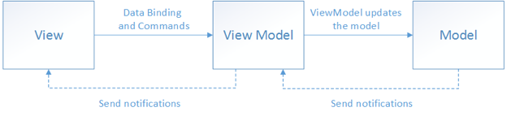
MVVM

Slide 27
MVVM
Demo

Slide 28
MVVM concepts
There is conceptually only ever one MODEL
Code in code-behind should be ABSOLUTELY MINIMAL
A ViewModel should ALWAYS implement INotifyPropertyChanged
A ViewModel may be used for more than one view

Slide 29
MVVM Design Patterns
Observer Pattern:
INotifyPropertyChanged
ObservableCollection<T>
Command Pattern:
ICommand

Slide 30
Thank You

